Slide 1
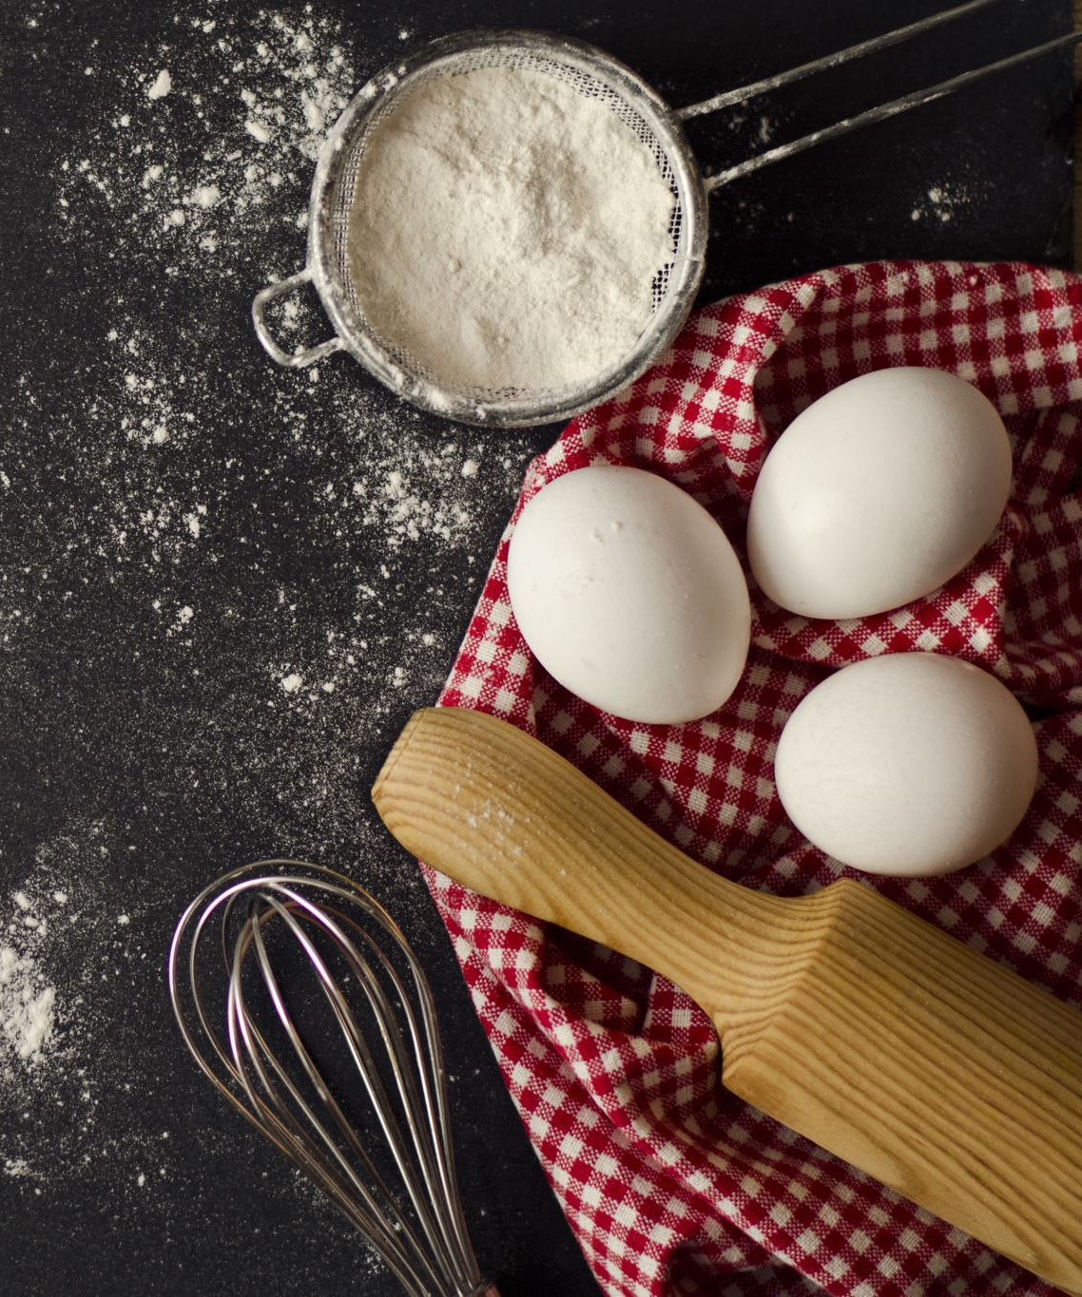
Predicting Popular Recipes
A solution for high-traffic forecast
Notes:
Hi, my name is Julio. I was given the task of helping your product team. I will tell you about
How we have approached the problem of predicting high-traffic recipes for our website

Slide 2
Business Goals
A solution for choosing which recipe will be shown on the home page.
A solution to predict which recipe will lead to high traffic (An increase of about 40% in traffic), with 80% of correct forecasts.
A solution for an automated fast decision process for picking the recipe.
Notes:
The product team noticed that some recipes have an increase in 40% of traffic when shown on the home page.
The producting is making the process of choosing manually, and there is no constraints when choosing the recipe.
We want to support the product team in creating a machine learning model that can correctly predict with 80% precision which recipe should be shown on home page.

Slide 3
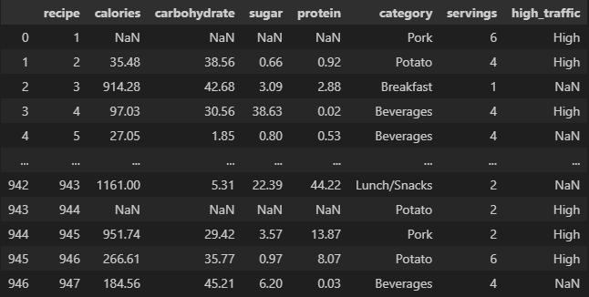
Data
Missing Values
Category Mismatch
Type Inconsistency
Missing Target Variable
Notes:
The high-traffic label highlights if there was an increase of 40% in traffic when using the recipe on the home page.
In the data, I had to deal with:
missing values,
Category Mismatch: ‘Chicken Breast’ and ‘Chicken’
And others cleaning tasks

Slide 4
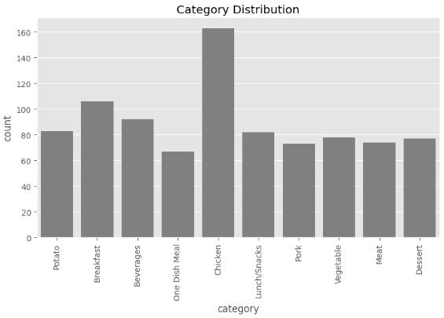
Key Findings
In this dataset, we have ten different categories.
Potato
Breakfast
Beverages
…
Notes:
Analysing category distribution, we can see that
The data is very balanced between **category**, except for the "Chicken" category, which has almost double the number of samples.

Slide 5
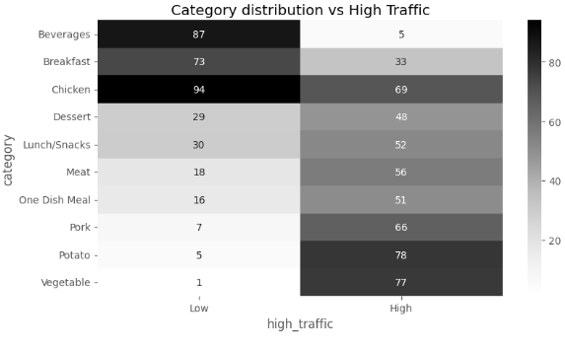
Key Findings
The table shows how many recipes from each category were responsible for High Traffic or not.
Big positive difference in ‘Vegetable’, ‘Potato’, and ‘Pork’,
To increase traffic, we can add recipes that are more likely to bring high traffic and reduce the unlikely others on our homepage.
Notes:
For example, when a ‘Vegetable’ recipe was shown on our home page, our website reached a high volume traffic seventy-seven times, and it didn’t achieve high traffic only once.
To increase traffic, we can add recipes that are more likely to bring high traffic and reduce the unlikely others on our homepage.

Slide 6
Model Development
calories
carbohydrate
Logistic Regression
High Traffic Recipe 1
sugar
protein
Random Forest Classifier
High Traffic Recipe 2
category
servings
The same features were used for training two models.
Notes:
I used two models to decide which performs better and solve our problem.
The Logistic Regression is more strong for linear patterns.
The Random Forest can capture non-linear models.

Slide 7
Outcomes
I used two metrics to evaluate the models: Precision and Specificity
Metrics | Precision | Specificity
Purpose | How likely we are to predict a High Traffic Recipe | How likely we are to predict a Normal Traffic Recipe
Range | 0-1 | 0-1
Notes:
Precision is crucial here because it helps measure how well the model predicts high-traffic recipes. We like that this value is above 80% for the company goal.
Specificity helps ensure that we avoid showing too many unpopular recipes, aligning with the goal of reducing the risk of low-traffic content.
We want both metrics to be as high as possible.

Slide 8
Outcomes
The Logistic Regression is performing better and it is aligned with the company goal
Model Name | Precision | Specificity
Logistic Regression | 0.80 | 0.70
Random Forest Classifier | 0.77 | 0.64
Notes:
The Precision value of the Logistic Regression model is approximately 0.80, indicating that the model correctly predicts high-traffic recipes 80% of the time. In comparison, the Random Forest Classifier achieves a Precision of about 0.77.
When evaluating Specificity, the Logistic Regression model shows a Specificity of approximately 0.70, and the Random Forest Classifier has a Specificity of around 0.65.
Overall, the results demonstrate that the Logistic Regression model has a higher Precision and better Specificity than the Random Forest Classifier. This suggests that logistic regression is more effective in minimizing the chances of incorrectly predicting recipes that will generate low traffic, which aligns with the goal of the analysis.

Slide 9
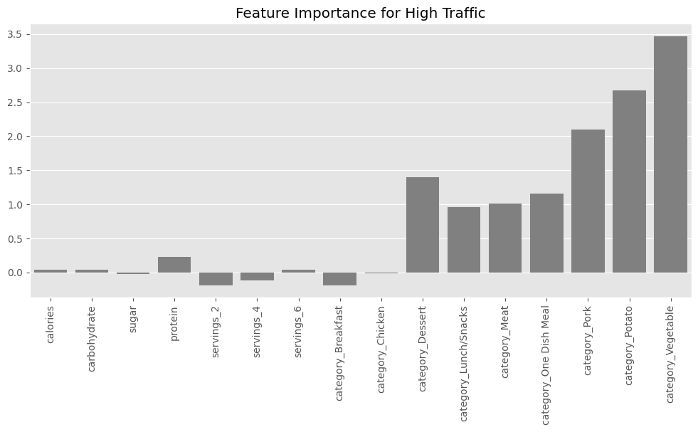
Outcomes
Logistic Regression
The most critical features for prediction are from the category features.
Notes:
In line with our first data exploration, we see that the category of our recipes greatly influences our traffic.
Recipes with 'Vegetable', 'Potato', and 'Pork' are very likely to drive high traffic, I recommend increasing the number of recipes within these categories.

Slide 10
Recommendation
Test Logistic Regression performing an A/B. Show some visitors only recipes that the model predicted as high traffic and compare with the control group.
Evaluate model performance by comparing how many times the model suggests recipes with high traffic, and this happened. The model should correctly predict 80% of the time.
Identify and fix errors after testing.
Deploy the model to predict how likely the recipe is to bring high traffic, and only use recipes with positive value on the website.
Gather additional data over time to refine and enhance the model’s precision, ensuring it adapts to changing trends in recipe popularity.
Notes:
To achieve the goal of predicting high-traffic recipes, I recommend utilizing the Logistic Regression model. With the Logistic Regression model achieving approximately 80% precision, we can expect reliable identification of recipes that will generate high traffic. To ensure effective implementation and continuous improvement, I suggest the following steps:

